Slide 1

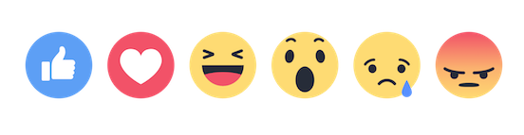
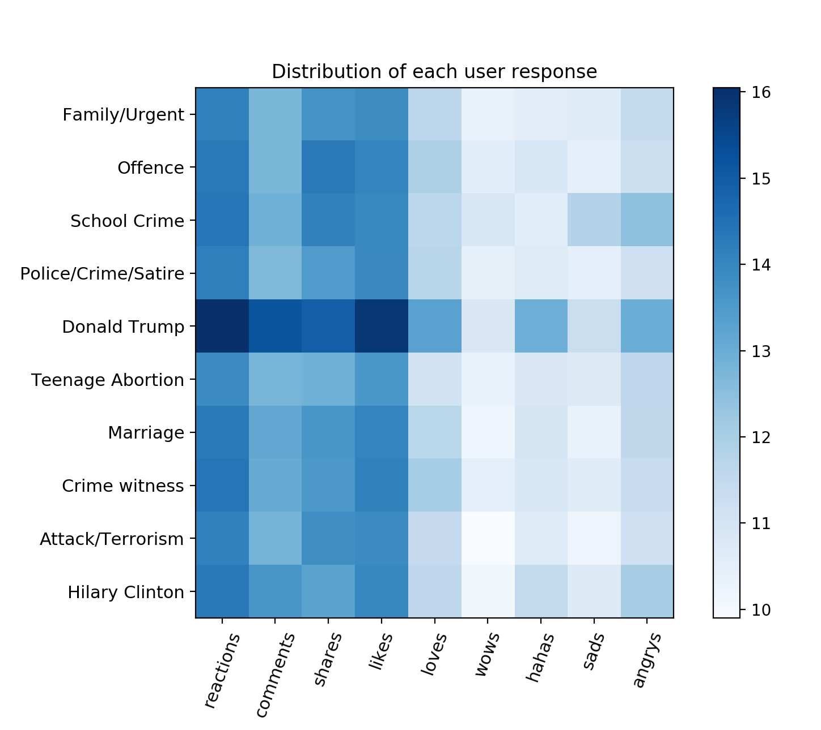
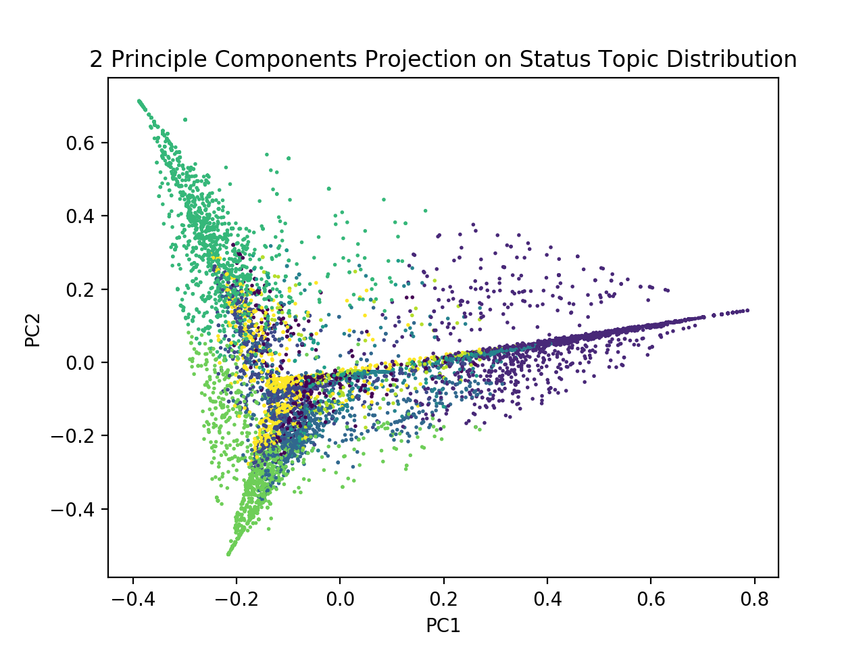
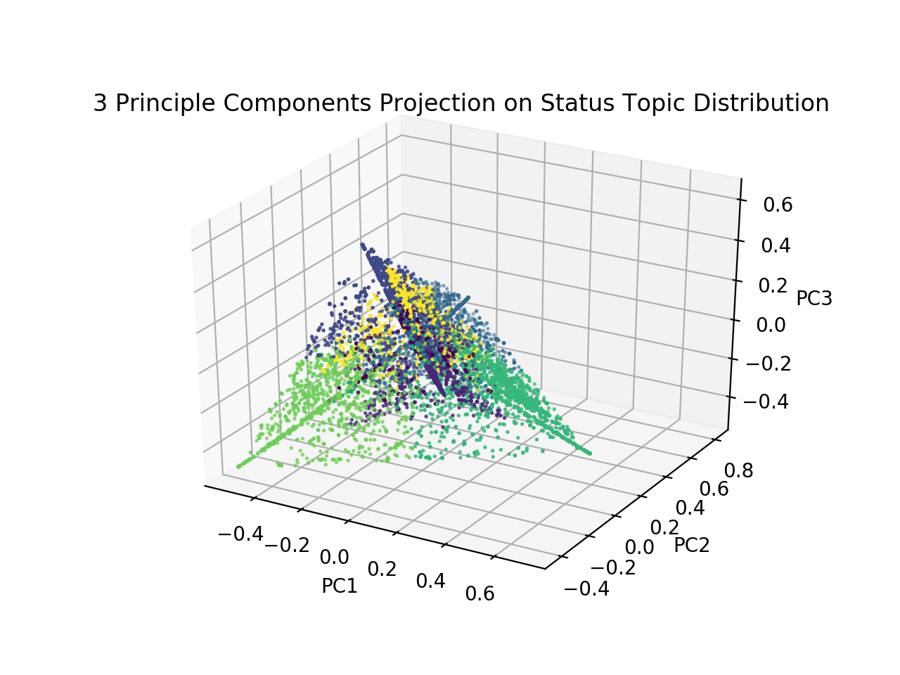
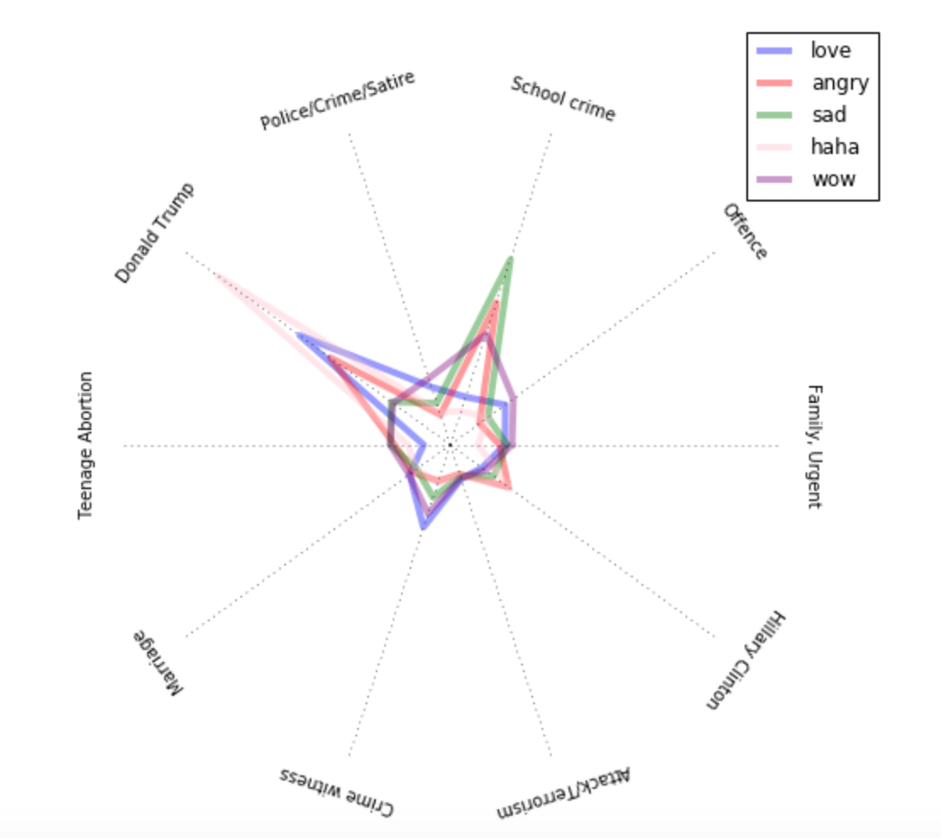
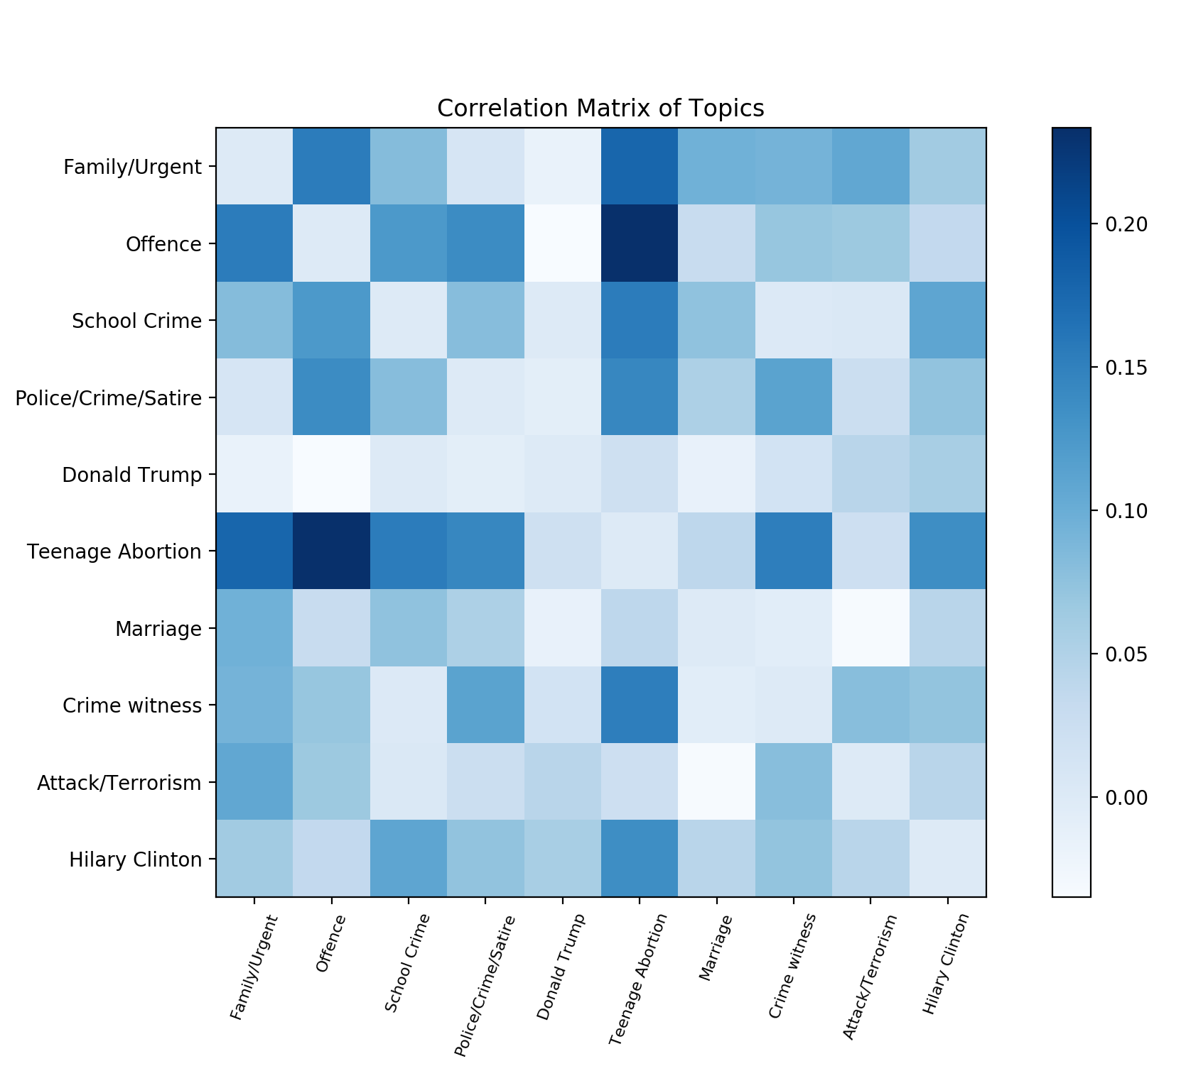
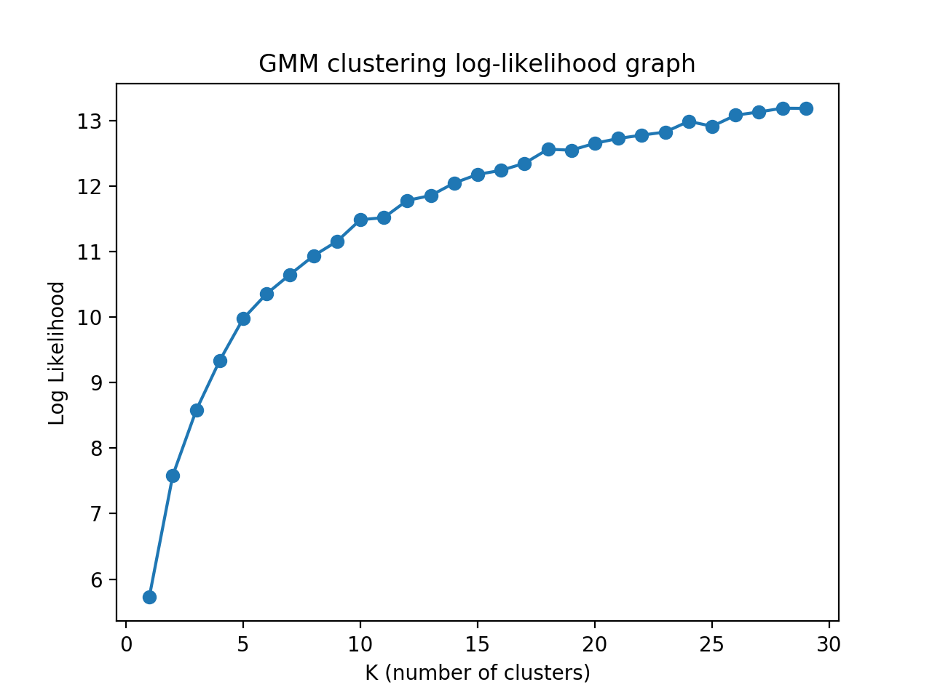
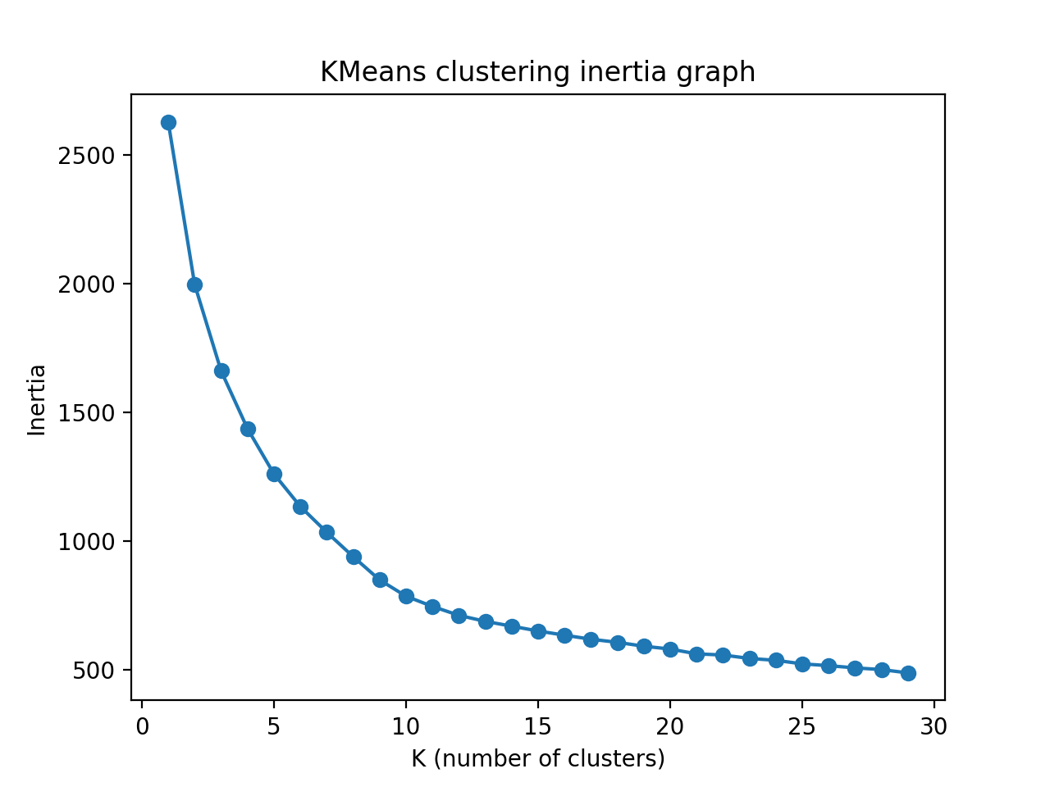
Facebook Status
Sentiment Analysis
INTRODUCTION
RESULTS
Sentiment Analysis is more than figuring out how people feel about in the social media. With sophisticated analysis on how people react to certain topics, sentiment analysis can predict the following: campaign success, marketing strategy, product messaging, customer service, and stock market price.
Recently, Facebook extended “like” by including “angry”, “wow”, “haha”, “love”, and “sad” reactions on posts, comments, and even messages.
Hailey Lee, Alex Ahn, Jae Park
OBJECTIVE
Extract data from a public Facebook page
Feature Learning: learning topic distributions of status using LDA (Latent Dirichlet Allocation)
Visualize Facebook statuses using PCA
Clustering: perform clustering to analyze distributions of learned features
FIGURES
METHODS
CONCLUSION
Select a public Facebook page for user sentiment analysis
Collect data including status and user responses
Perform LDA on status corpus and generate topic vectors
Assign most relevant topic label to each status
Perform PCA to visualize topic distribution
Visualize correlation matrix of the topic distribution
Visualize user responses to each topic
Cluster status corpus using topic-features (KMeans, GMM)
Plot likelihood/inertia for each K-number of clusters for each method
Able to observe/tracked distributions of different topics under “Opposing View” in the Facebook group page.
We chose 10 topics to be able to interpret the results more clearly.
From August 2016 to April 2017, as we can see from the graph, Donald Trump took the majority of attention, especially because it is politically highly debated topic.
From clustering, (both K-means and GMM), we observed that likelihood approximately converges after 10 cluster mean. This means that topics are usually combined with one another for each status.
According to the correlation matrix, we noticed that Teenage abortions, Family issues, and Offense are highly correlated with one another. Police Crime Satire is likely correlated with crime witness, while Donald Trump is not correlated with anything in topic distribution of each status.
Further implications: apply to the other page, and we can possibly predict how people react sensitively to certain topics.
Explained variance with 2 eigenvectors: 0.390087%
Explained variance with 3 eigenvectors: 0.531836%
Complex Radar graph of topics
Generated Topics
Topic #1 (Offence):
woman man young words knew began didn judge stop suddenly got went took felt inside later received way home offended
Topic #3 (Police/Crime/Satire):
police car officer woman saw wasn life pulled just officers left door arrived won couple looked hard cop driver soon
.
.
.
REFERENCES
[1] https://github.com/minimaxir/facebook-page-post-scraper
[2] https://medium.com/@baditaflorin/understanding-facebook-reactions-using-sentiment-analysis-f17b6e561ff3

